Slide 1
Chapter: Protection and Security

Slide 2
Objectives
Discuss the goals and principles of protection in a modern computer system
Explain how protection domains combined with an access matrix are used to specify the resources a process may access
Examine capability and language-based protection systems

Slide 3
Goals of Protection
Process in OS must be protected from the one another.
Protection refers to a mechanism for controlling the access of the programs, processes or users to the resources defined by the computer system.
Protection improves reliability.
Protection Mechanism determine: how some thing will be done
Policy determine: what is to be done.
This mechanism must provide a means for specifying the controls to be imposed, together with a means of enforcement.

Slide 4
Protection in Computer System
System with Contiguous memory allocation:
  Protection is achieved by Use of Limit Registers
In Paging System:
  Protection is achieved by use of Page Table. Each process has its own page table.
In System with Segmentation:
  Protection is achieved by Use of Segment Table – Each table is protected by base address and limit register
In System with files stored on Secondary Storage:
  Protection is achieved by Access Rights

Slide 5
Access Control
Method that determines:
  What types of access are permitted on different resources
  Under what circumstances
  By Whom

Slide 6
Access Control
Access Control Model has 3 basic components:
  Subjects (S) or Domain: Represents a finite set of entities that have access to current object.
    Subject may be: User , Process or Procedure
  Objects (O): Represents a finite set of resources that need access.
    Object may be: H/w device ( processor, memory) Or S/W resources ( page table, files etc)
  Rights ( R): Represents a finite set of Operations that a Subject can perform on Object.

Slide 7
Discretionary Access Control/ Access Matrix
Discretionary Access Control Model is represented by Access Matrix.
It is used to describe which users have access to what objects or resources.
Access Matrix consists of Rows and Columns
Rows represent : Current Subject / Domain
Column represent: Current Object

Slide 8
Discretionary Access Control/ Access Matrix
View protection as a matrix (access matrix)
Rows represent domains
Columns represent objects
Access(i, j) is the set of operations that a process executing in Domain_{i} can invoke on Object_{j}

Slide 9

Access Matrix

Slide 10
Use of Access Matrix
If a process in Domain D_{i} tries to do “op” on object O_{j}, then “op” must be in the access matrix
Operations to add, delete access rights
  Special access rights:
    owner of O_{i}
    copy op from O_{i} to O_{j}
    control – D_{i} can modify D_{j} access rights
    transfer – switch from domain D_{i} to D_{j}

Slide 11
Implementation of Access Matrix
There are 2 methods:
1. Access Control Lists
  ACL can be created by dividing Access Matrix Column Wise.
  Separate list is maintained for each domain and each object.
  It skips blank row entries in each domain.
2. Capability List
  Can be created by dividing Access Matrix Row Wise.
  It is list of access rights that a user / domain or a process has for a object.
  It is divided into 2 fields:
    Object Descriptor
    Access Rights

Slide 12
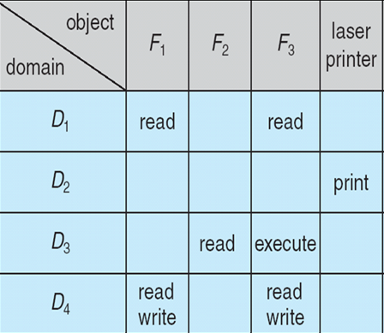
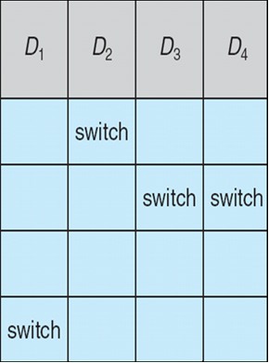
Access Matrix With Domains as Objects

Slide 13
Operation on Access Matrix Entries
1. Copy
  It allows the access right to be copied only within the column (for an object)
  Ability to copy an access right from one domain (row) to another is denoted by asterisk ( * )
  The ability to copy rights is denoted by an asterisk, indicating that processes in that domain have the right to copy that access within the same column

Slide 14

Access Matrix with Copy Rights
For example, in Figure
(a), a process executing in domain D2 can copy the read operation into any entry associated with file F2.
Hence, the access matrix of Figure (a) can be modified to the access matrix shown in Figure(b).

Slide 15
Operation on Access Matrix Entries
2. Owner
  It allows addition or removal of access rights.
  If any access includes owner right then a process executing in domain Di can add or remove any access right in entry of that column.
Copy and Owner allow a process to change the entry in column.

Slide 16
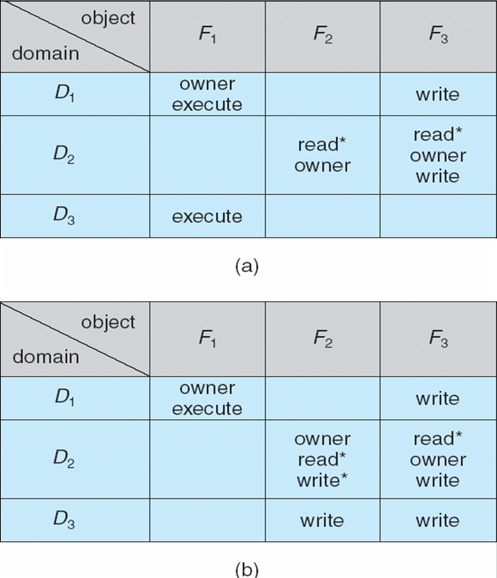
Access Matrix With Owner Rights
If access(i, j) includes
the owner right, then a process executing in domain Di can add and remove any right in any entry in column j.
For example, in Figure (a), domain D1
is the owner of F1 and thus can add and delete any valid right in column F1.
Similarly, domain D2 is the owner of F2 and F3 and thus can add and remove
any valid right within these two columns. Thus, the access matrix of Figure
(a) can be modified to the access matrix shown in Figure (b).

Slide 17
Operation on Access Matrix Entries
3. Control Right
  Control right mechanism used to change entries in a row.
  Control right is applicable only to domain objects.
  If access( i , j ) includes control right, then a process executing in domain Di can remove any access right from row j.
  Switch operation works for column only

Slide 18

Operation on Access Matrix Entries
For example, suppose that, we include the control right in access(D2, D4). Then, a process executing in domain D2 could modify domain D4, as shown.

Slide 19
Security
Method of protecting information stored in the system from un-authorized access.
Security must consider external environment of the system, and protect it from:
  unauthorized access.
  malicious modification or destruction
  accidental introduction of inconsistency.
Security violation can be categorized as intentional or accidental.
Security is a measure of confidence that the integrity of a system and its data will be preserved.

Slide 20
Some Security Violations
Breach of Confidentiality: Unauthorized reading of data. Theft of information
Breach of integrity: Unauthorized modification of data.
Breach of availability: Unauthorized destruction of data/ website defacement:
A website defacement is an attack on a website that changes the visual appearance of the site or a webpage.
Theft of service: Unauthorized use of resources.
Denial of service: Send invalid data to applications or network services, which cause abnormal termination.
Flood a computer or the entire network with traffic until a shutdown occurs because of the overload.

Slide 21
Security Measure Levels
To protect our system, we must take security measures at 4 levels:
Physical - Secure Hardware Components
Human – Use Passwords for protection
Operating system – Use Valid Login and Password
Network – Use authentication and anti-virus to protect data/ resources over the network.

Slide 22
Program Threats
Writing a program that creates a breach of security or causing a normal process to change its behavior and create a breach is the common goal of crackers
Malware: A destructive program that pretend to be a gentle application.
A back door is a means of access to a computer program that bypasses security mechanisms.

Slide 23
Program Threats
1. Trojan horse
A Trojan horse, or Trojan, is software that appears to perform a desirable function for the user, but steals information or harms the system.
Trojan horse is a program in which harmful code is contained in such a way that it can get control and do its chosen form of damage.

Slide 24
1. Trojan horse
For example: A text-editor program, may include code to search the file to be edited for certain keywords. If any are found, the entire file may be copied to a special area accessible to the creator of the text editor.
A code segment that misuses its environment is called a Trojan horse.

Slide 25
1. Trojan horse
A variation of the Trojan horse is a program that emulates (copy) a login program.
An unsuspecting user starts to log in at a terminal and notices that he has apparently mistyped his password. He tries again and is successful.
What has happened is that his authentication key and password have been stolen by the login emulator, which was left running on the terminal by the thief.
The emulator stored away the password, printed out a login error message, and exited; the user was then provided with a genuine login prompt.

Slide 26
2. Spyware
A software that secretly monitors the user's computing.
Spyware is a type of malware that can be installed on computers, and which collects small pieces of information about users without their knowledge.
The presence of spyware is typically hidden from the user, and can be difficult to detect.
Sometimes, Spywares are installed by the owner of a shared, corporate, or public computer in order to secretly monitor other users.

Slide 27
2. Spyware
Spyware sometimes accompanies a program that the user has chosen to install.
The goal of spyware is to download ads to display on the user’s system, create pop-up browser windows when certain sites are visited, or capture information from the user’s system and return it to a central site.

Slide 28
3. Trap Door
The designer of a program or system might leave a hole in the software that only designer is capable of using. This type of security breach is called trap door.
For instance, the code might check for a specific user ID or password
A clever trap door could be included in a compiler. The compiler could generate standard object code as well as a trap door, regardless of the source code being compiled.

Slide 29
4. Logic Bomb
Consider a program that initiates a security incident only under certain circumstances.
Under normal operations, there would be no security hole. However, when a predefined set of parameters was met, the security hole would be created. This scenario is known as a logic bomb.
for example, A programmer, might write code to detect whether he is still logged in if that check failed, a daemon could be generated to allow remote access, or code could be launched to cause damage to the site.

Slide 30
5. Stack and Buffer Overflow
The stack- or buffer-overflow attack is the most common way for an attacker outside the system, on a network or dial-up connection, to gain unauthorized access to the target system.
the attacker exploits a bug in a program. The bug can be a simple case of poor programming, in which the programmer neglected to code bounds checking on an input field. In this case, the attacker sends more data than the program was expecting.

Slide 31
6. VIRUS
VIRUS: Vital Information Resource Under Seize or Very Important Resource Under Seize
Fragment of malicious code embedded in a genuine program.
designed to “infect” other programs.
Specific to architecture, operating systems and applications.
Needs human intervention to move from host to host.
Needs some one to actually take that program from one device and run it onto other device
Does not self replicate itself

Slide 32
System and Network Threats
Program threats typically use a breakdown in the protection mechanisms of a system to attack programs.
System and network threats involve the abuse of services and network connections.
System and network threats create a situation in which operating-system resources and user files are misused.

Slide 33
1. Worms
Self propagating.
A worm is a process that uses a mechanism to duplicate itself. The worm copies of itself, using up system resources and perhaps locking out all other processes.
If a device gets infected, it sends the copies of itself onto the network to other devices.
Sometimes more disturbing, it might go into your email, find your contacts, sends copies of itself to all the contacts.

Slide 34
MCQ
SSTF algorithm, like SJF __________ of some requests.
a) may cause starvation
b) will cause starvation
c) does not cause starvation
d) causes aging
Notes:
a

Slide 35
MCQ
In the ______ algorithm, the disk arm goes as far as the final request in each direction, then reverses direction immediately without going to the end of the disk.
a) LOOK
b) SCAN
c) C-SCAN
d) C-LOOK
Notes:
a

Slide 36
MCQ
Which of the following is not an operating system?
A. Windows
B. Linux
C. Oracle
D. DOS
Notes:
C

Slide 37
MCQ
If the page size increases, the internal fragmentation is also --------------- ?
A. Decreases
B. Increases
C. Remains constant
D. None of these
Notes:
B

Slide 38
MCQ
If a page number is not found in the translation lookaside buffer, then it is known as a?
A. Translation Lookaside Buffer miss
B. Buffer miss
C. Translation Lookaside Buffer hit
D. All of the mentioned
Notes:
A

Slide 39
MCQ
In contiguous allocation _____________
a) each file must occupy a set of contiguous blocks on the disk
b) each file is a linked list of disk blocks
c) all the pointers to scattered blocks are placed together in one location
d) none of the mentioned
Notes:
A

Slide 40
MCQ
In linked allocation _____________
a) each file must occupy a set of contiguous blocks on the disk
b) each file is a linked list of disk blocks
c) all the pointers to scattered blocks are placed together in one location
d) none of the mentioned
Notes:
b

Slide 41
mcq
What is Domain?
a) Domain = Set of all objects
b) It is a collection of protection policies
c) Domain= set of access-rights
d) None of the mentioned
Notes:
c

Slide 42
mcq
For a domain _______ is a list of objects together with the operation allowed on these objects.
a) capability list
b) access list
c) both capability and access list
d) none of the mentioned
Notes:
a

